Slide 1

Detecting Neutrinos via Active Radar Sounding
Richard Moser,
The University of Kansas

Slide 2
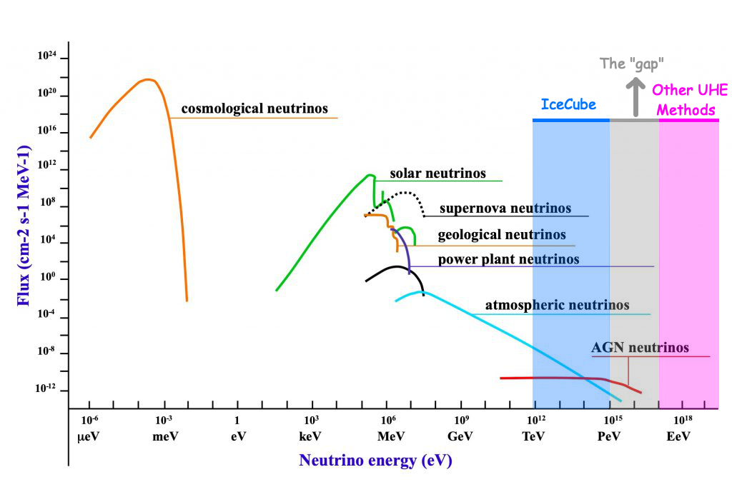
Notes:
As a quick review, in the energy spectrum of neutrinos, there exists a gap in our current capabilities to effectively detect Ultra High Energy neutrinos. The active radar sounding method offers a chance to peel back the curtain and illuminate this energy range.

Slide 3
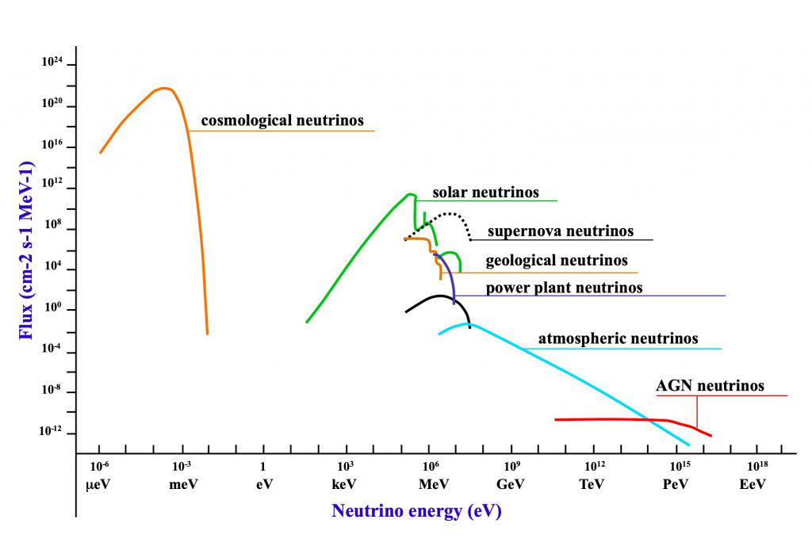
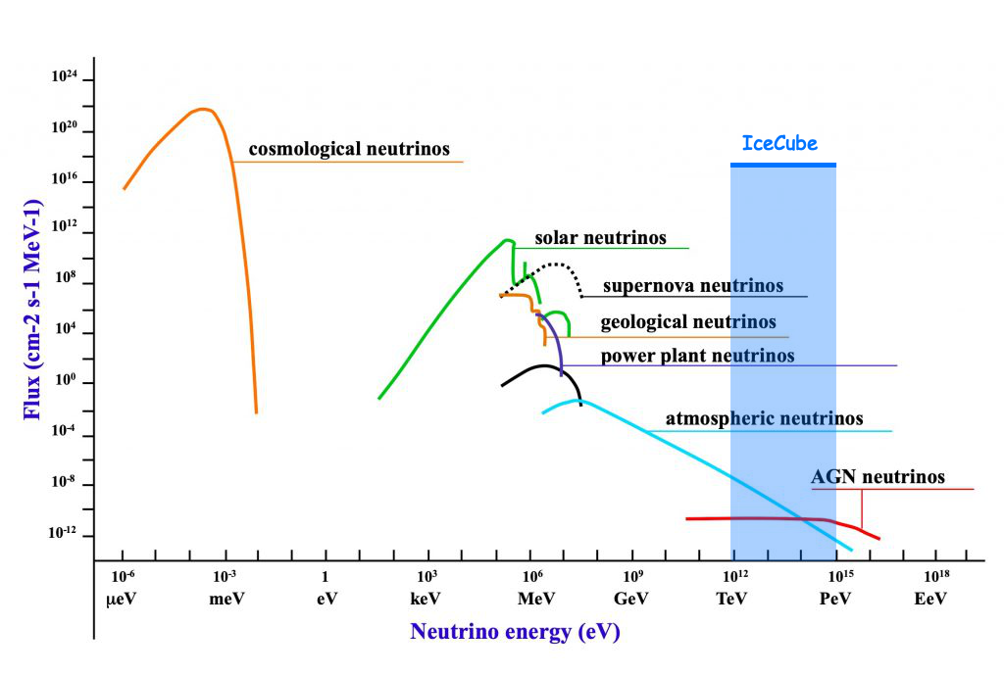
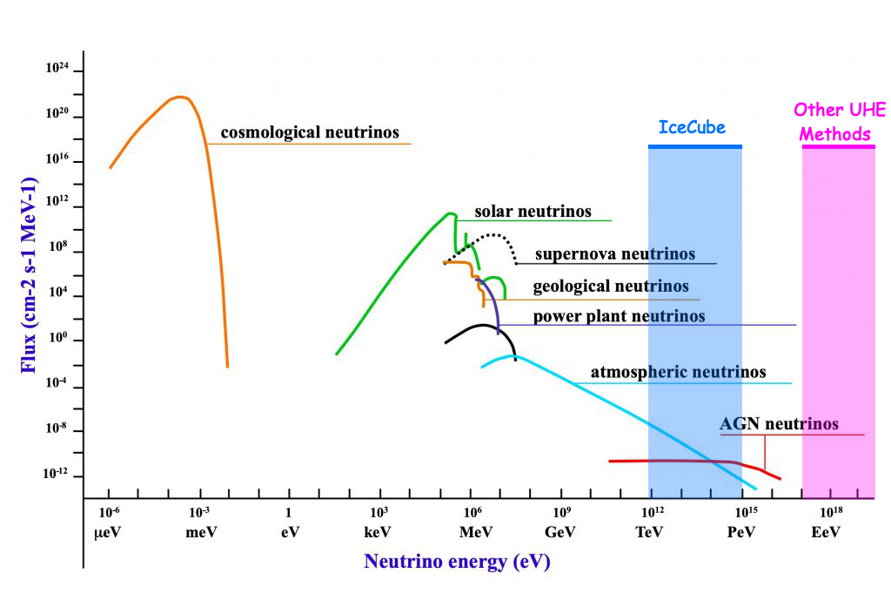
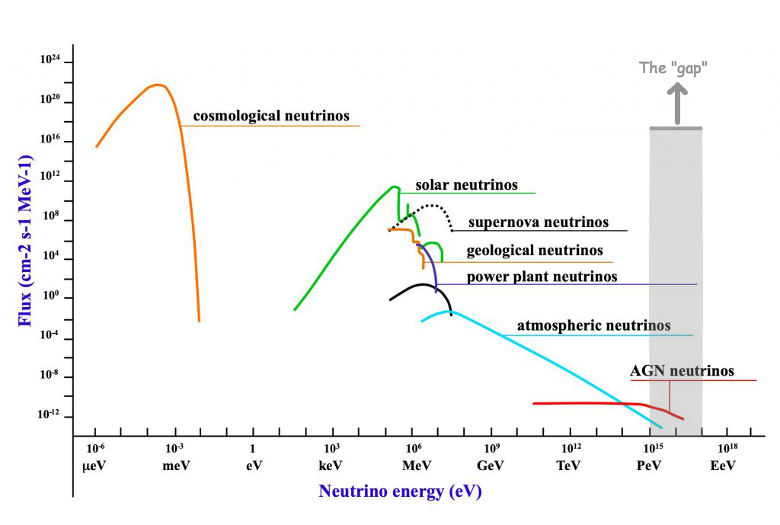
Notes:
UHE ≥ 10¹⁶ eV

Slide 4
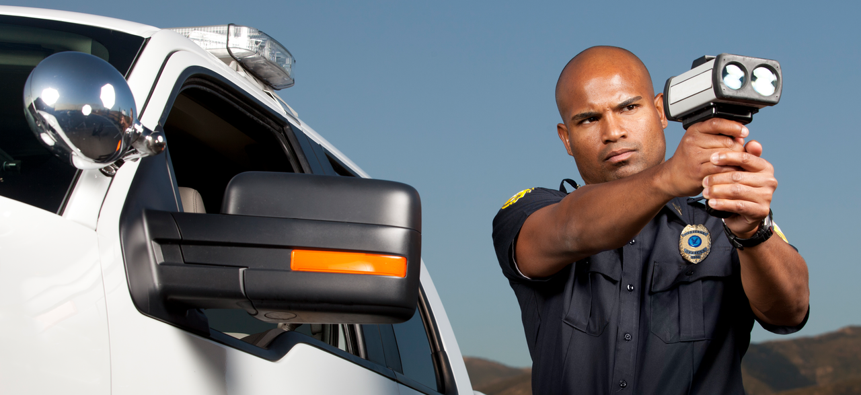
The case for active radar emission based neutrino detection methods
“Sir, you were going 6.706e8 in a 35”

Slide 5
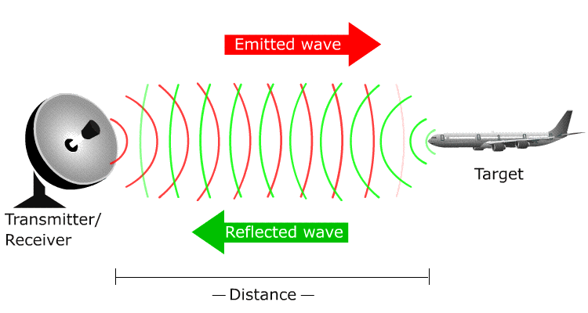
RADAR - RAdio Detection And Ranging
Requirements: Transmitter (TX), target, receiver

Slide 6
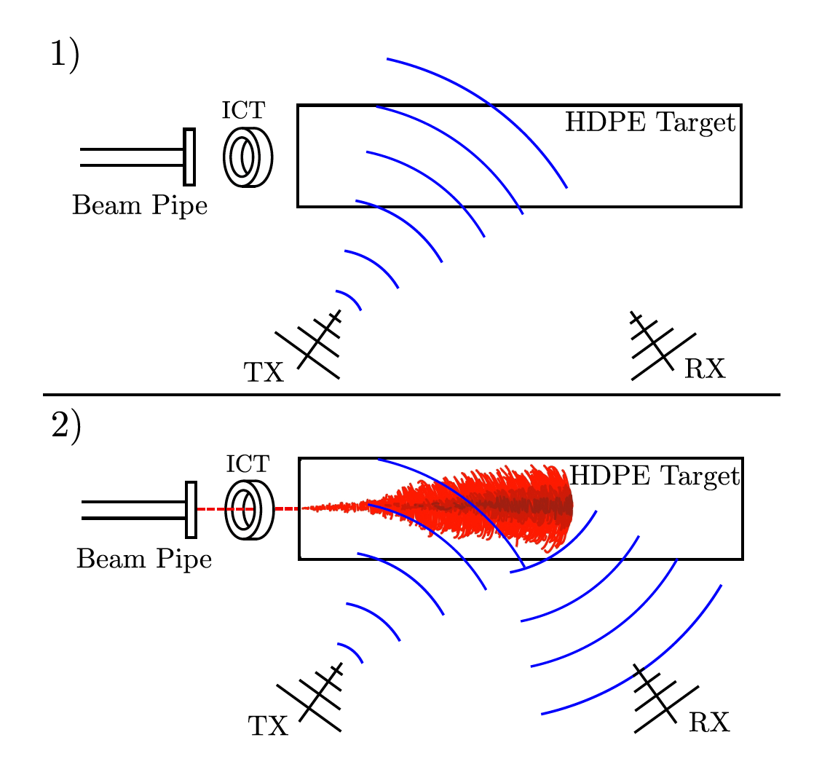
Experimental Data
Conducted at SLAC in May and October 2018
“We broadcast CW radio at a range of frequencies between 1 and 2.1 GHz and a range of amplitudes, using a signal generator, 50Wpower amplifier, and transmitting antenna (TX) toward a target of high-density polyethylene (HDPE), into which the electron beam was directed. Receiving antennas (RX) were also directed at this target to measure the radar reflection.”
Notes:
integrating current toroid (ICT) which gave a precise measurement
of the charge in each bunch

Slide 7
Review: Advantages of active sounding
RX signal strength scales with TX signal power, not just particle energy
Detection outside of the cone
The “plane” doesn’t have to hit the RX for the RX to see it
Greater detection range = lower sensor density = larger array
Better anthropogenic and background noise rejection
Received signal should closely match transmitted signal
Continuous CW pulse – from TX in shadow zone (?)
Active detection sensitivity should peak in the 10-100PeV range

Slide 8

Radio Scatter
Fancy simulation software with a few quirks
Confusing geometry
Very loud thermal noise

Slide 9
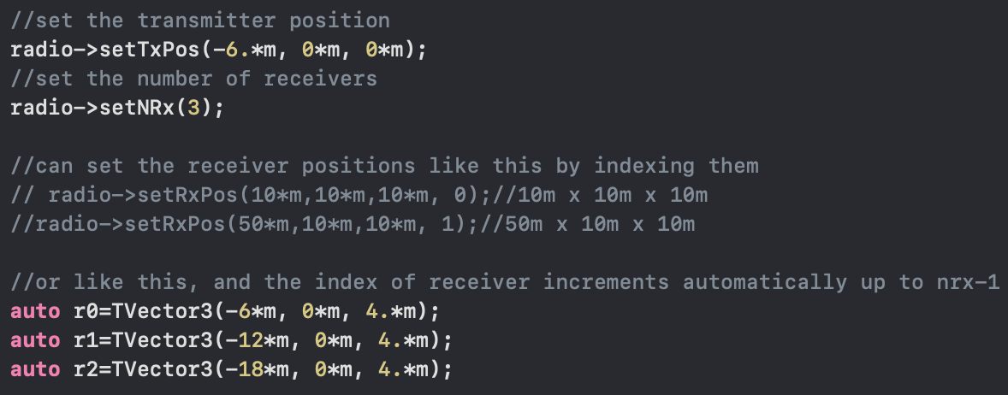
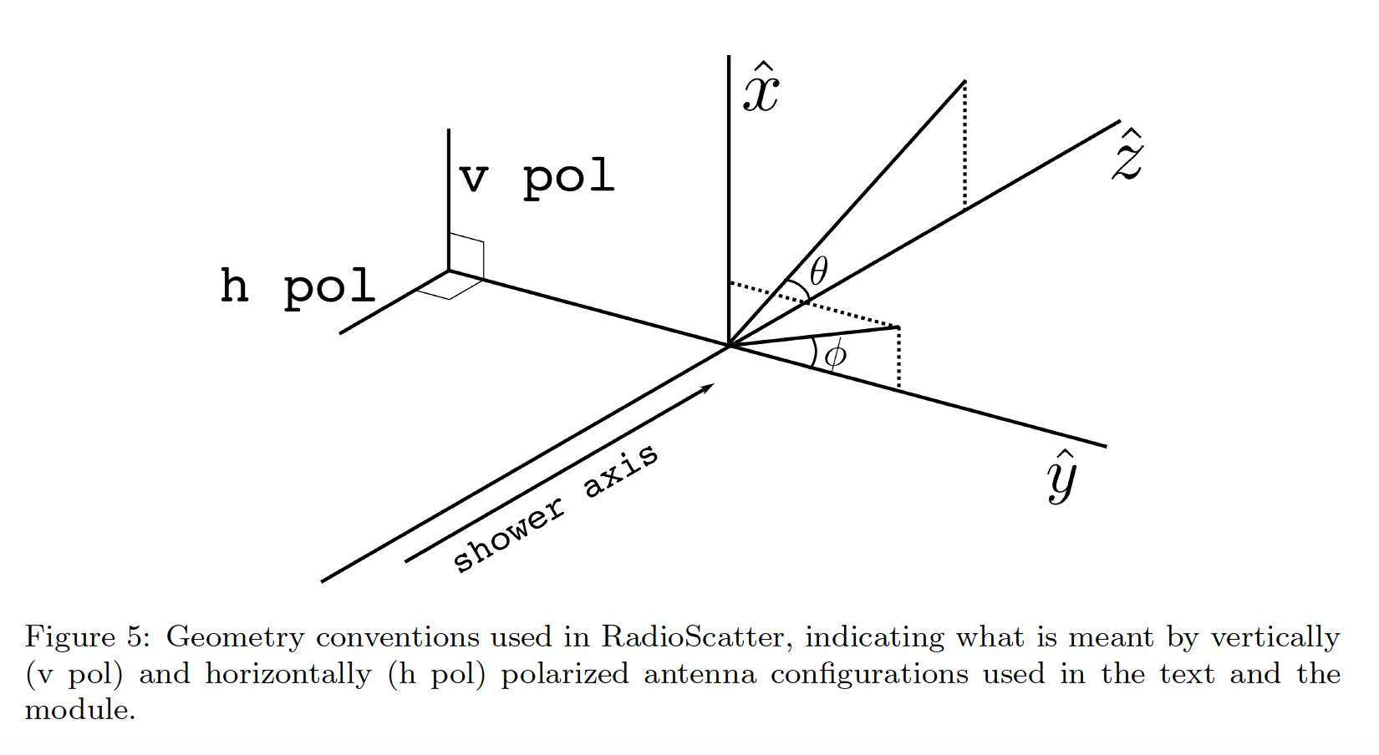
The geometry question

Slide 10
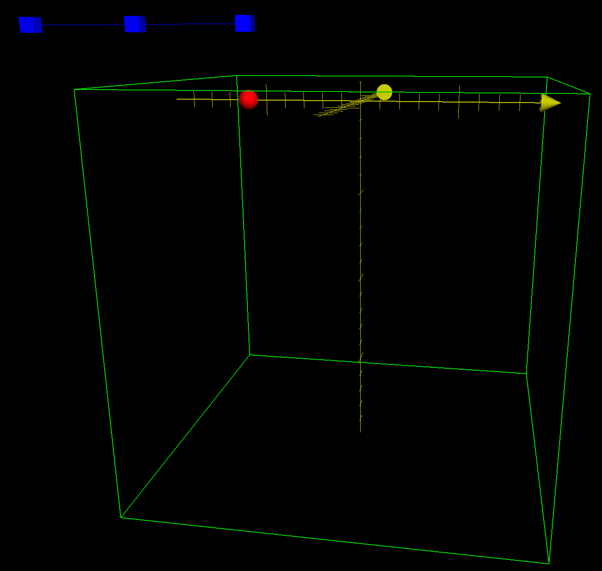
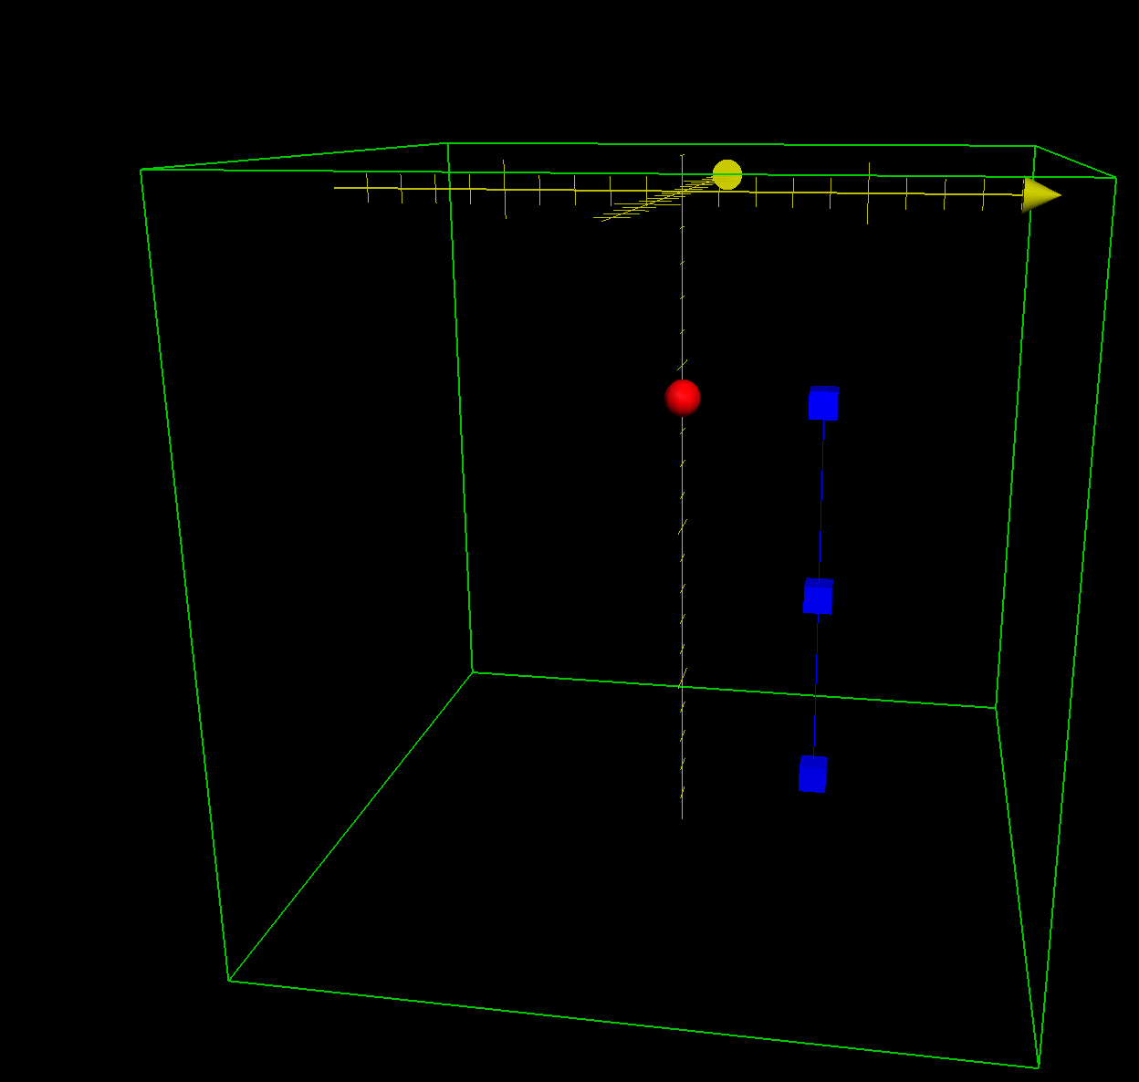
(x,y,z)
(z,y,x)

Slide 11
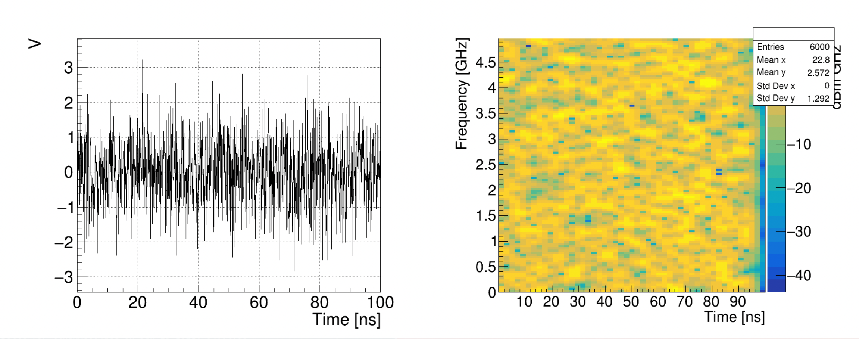
The noise issue

Slide 12
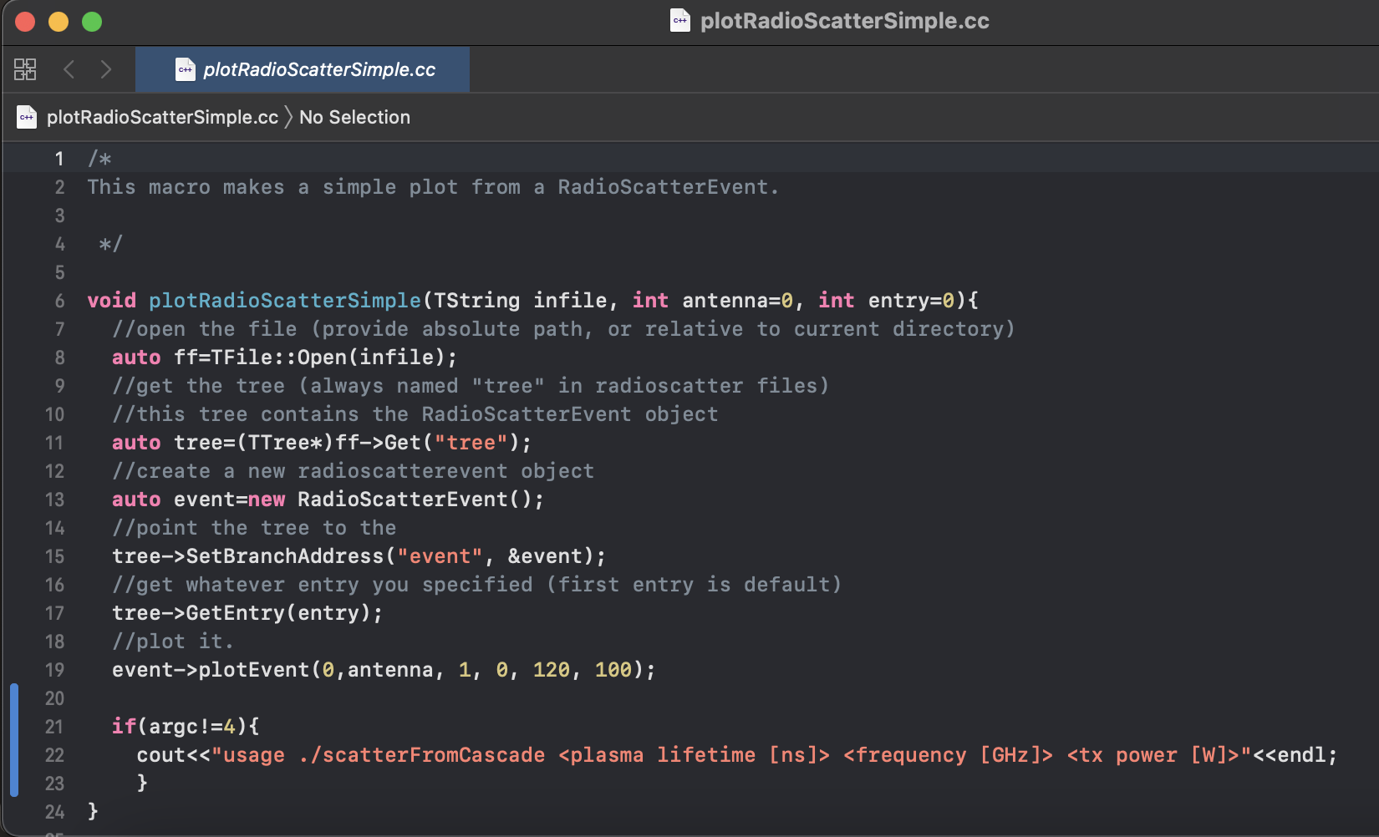
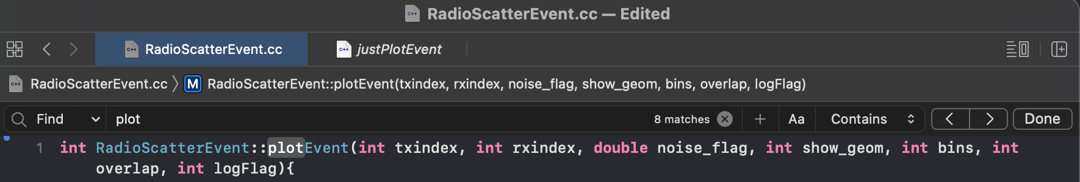
Notes:
This is the macro used to generate the plots
Here is the plotEvent function it is calling and the noise flag argument is set to 1, telling it to make noise.
Why is the noise so high? Why is it set to 1 as a default? I also had ROOT set up such that it wasn’t accepting the value being changed to 0 which caused some irritation in troubleshooting.

Slide 13
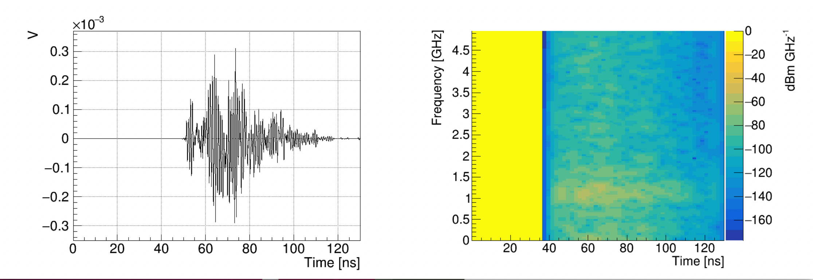
Getting closer
Notes:
On the left we see a clean, noiseless waveform reflected off of the digital plasma from the shower shower. On the right is a spectrogram which shows a wide swath. Oddly the swath starts at about 37 nanoseconds while the waveform pulse begins around 50ns from t-zero

Slide 14
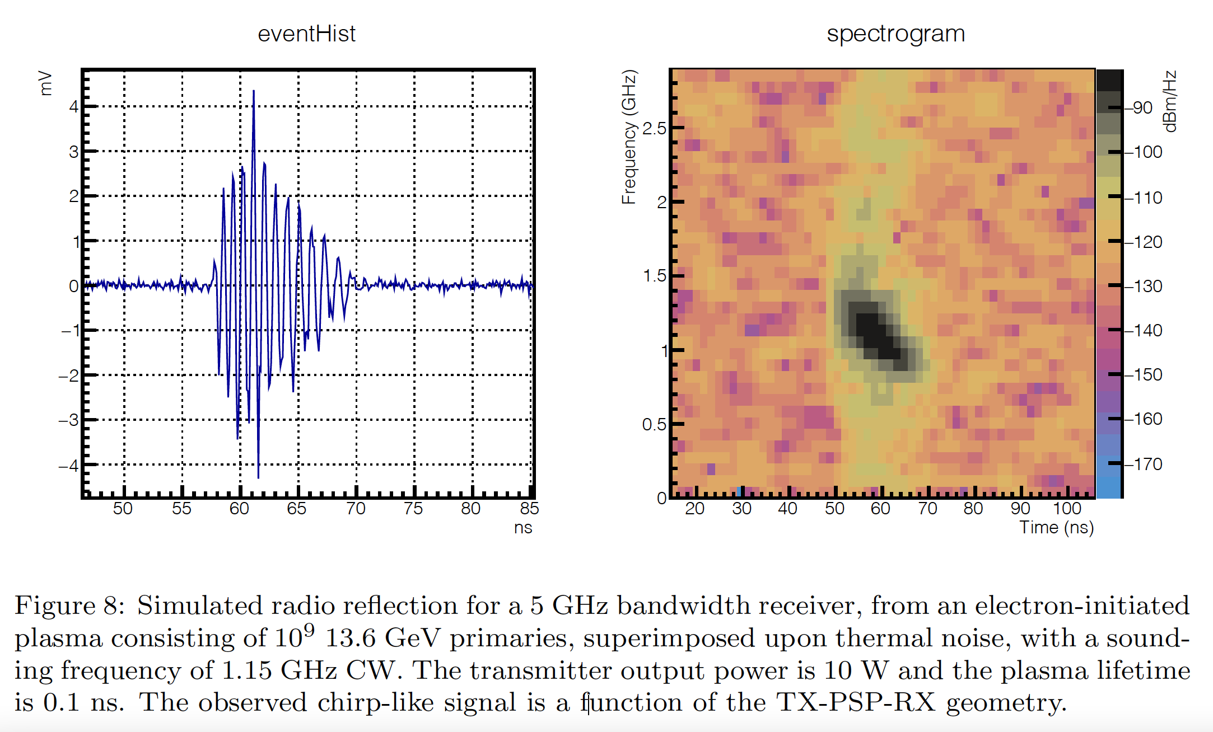
The ideal return
Notes:
In the radio talk a week ago I asked if this was even a useful way to plot the data. This is a prettied up plot of a better return. Notice that the waveform shows noise but the received signal rises out of it nicely. In the spectrogram, the chirp shows up relatively narrow and discrete from the surrounding background. The spectrogram plotting frequency, time, and intensity against one another is very useful for rapid qualitative recognition. This is how passive sonar data is interpreted in a time frequency LOFAR display (Low Frequency Analysis and Ranging). Why is it black though? i.e. low intensity?
Sidebar: if anyone wants me to talk offline (or in here) about why the rays trace like they do and why some of this stuff works I can do that. I say that only because a few people have asked or gotten me on that tangent and said “oh that makes sense now.”

Slide 15
The path forward
Testing different geometries and power levels
Optimize settings for discreet chirps vice broadband swaths
Determine effective and efficient geometries
Build it!
The University of Kansas will build a test transmitter this year for the Radio Echo Telescope (RET) group at some point this year

Slide 16
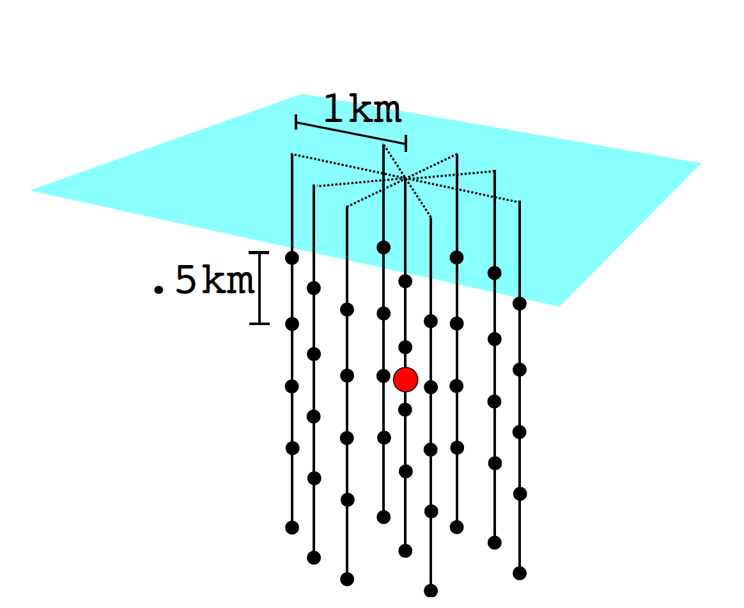
Example detector

Slide 17
Info, data, chart sources
Particle-level model for radar based detection of high-energy neutrino cascades
S Prohira, D Besson: 2017
https://arxiv.org/abs/1710.02883
Observation of Radar Echoes From High-Energy Particle Cascades
S. Prohira, K.D. de Vries, P. Allison, J. Beatty, D. Besson, A. Connolly, N. van Eijndhoven, C. Hast, C.-Y Kuo, U.A. Latif, T. Meures, J. Nam, A. Nozdrina, J.P. Ralston, Z. Riesen, C. Sbrocco, J. Torres, S. Wissel: 2019
https://arxiv.org/abs/1910.12830

Slide 18
Questions, Critiques, Complaints?

